Slide 1
Escaping Area 51!
Game Proposal
by Tom Robinson

Slide 2
My Game……
2D platformer where you are an 'E.T' who is trying escaping from Area 51.
With only your bare fists as protection you must fight your way through the oncoming military and any other conspiracy theorists you may come across on your way to finding the mothership!
Ps you may want to collect the parts to fix the ship on your way!

Slide 3
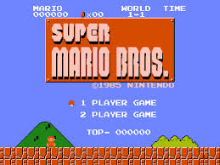
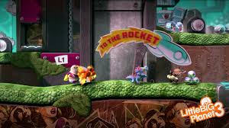
Why 2D Platformer?
2D platformers have stayed ever popular throughout the computer gaming life cycle
Super Mario clearly the best selling game for the NES
Still selling millions of copies on the latest consoles of today.
With the clear success of the 'Mario bros' series it is a good starting platform to create other games based around the same theme and character(s). Or using the knowledge obtained from this series move onto a more complex 2D platformer, like PlayStation did for the 'Little Big Planet' series.

Slide 4

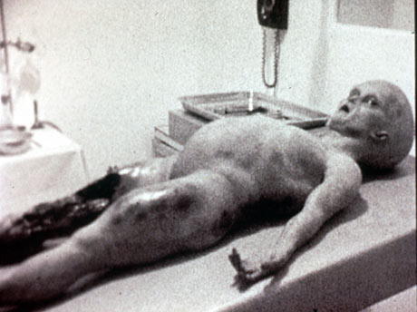
What is Area 51?
Dubbed by many as 'the most secretive place on earth‘
Used as a base to control covert operations during the cold war
Now top secret location where, for many who believe, the U.S government to hide 'extraterrestrials' and other alien objects.
Under constant heavy military patrol and is said to be the location for Earths seemingly only visit from aliens, known as the 'Roswell Crash
Although a government statement later stated this to be a weather balloon.

Slide 5
MoSCoW – Must Have
2 dimensions
Moving player
Multiple levels
Strong theme

Slide 6
MoSCoW – Should Have
Enemies that can harm the player
A player with an attack of some sort
Collectables

Slide 7
MoSCoW – Could Have
Moving enimies
Different level designs
Multiple types of enemy

Slide 8
MoSCoW – Would Have
A ‘Ghost Time’ – this is where there would be your previous best attempt / time playing alongside your current attempt in a ‘ghostly’ shade.
A Space mission, where the player controls the mothership and has to avoid missiles coming from earth to destroy it.

Slide 9
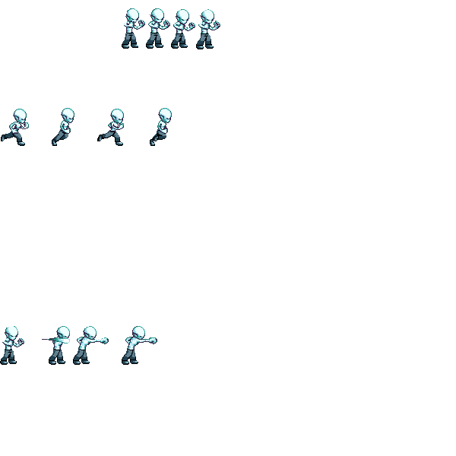
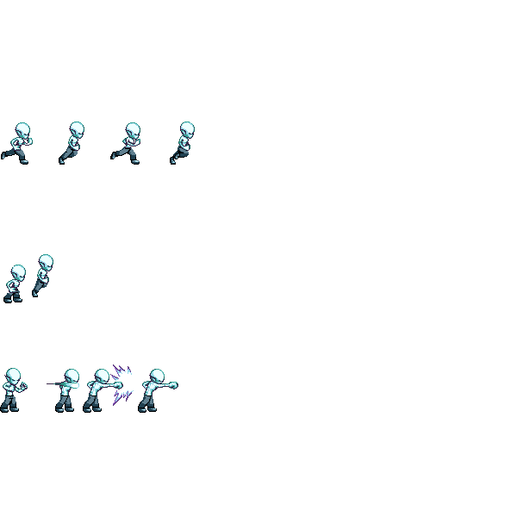
Alien Sprite Sheet
Idle
Running
Jumping
Punching

Slide 10
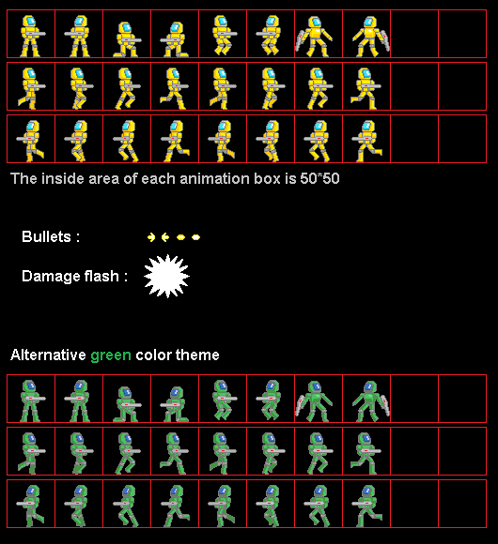
Enemy Sprite Sheet

Slide 11
Level Design

Slide 12
Summary
During my game the user will be able to move left, right and jump.
As well as being able to jump the user will also be able to make the character punch enemies (shown in pervious slide)
The user will work on a level by level basis, all of which will have different terrains
There will be 3 different backgrounds on the final product, with the enemy changing with the background.
These enemies will be throwing / shooting some sort of projectile at the player

Slide 13
Any Questions???

